Slide 1

High-Level Design
Team 7- Service Charge App
Version No: 1.0 Updated By: Lj Vincent Tudtud
Approved By:

Slide 2
Revision History
Rev No. | MODIFIED BY | MODIFIED DATE | REMARKS | PRELIMINARY REVIEW AND APPROVAL | DATE REVIEWED | FINAL REVIEW AND APPROVAL | DATE APPROVED
1.0 | Tudtud, Lj Vincent | 2023/02/04 | Initial Creation | Last Name, First Name | yyyy/mm/dd | Last Name, First Name | yyyy/mm/dd

Slide 3
Screen Details
Team - 7

Slide 4
Screen List
Screen | Description | Remarks
Sign In Page 1.0 | User will login here
Sign Up Page 1.1 | User will register here
Forgot Password Page 1.2 | User will send an otp to his email through this page
Reset Password Page 1.2.1 | User will reset his password through this page
Main Page 1.3 | This is the users main page
Profile Page 1.4 | This is the users profile page

Slide 5
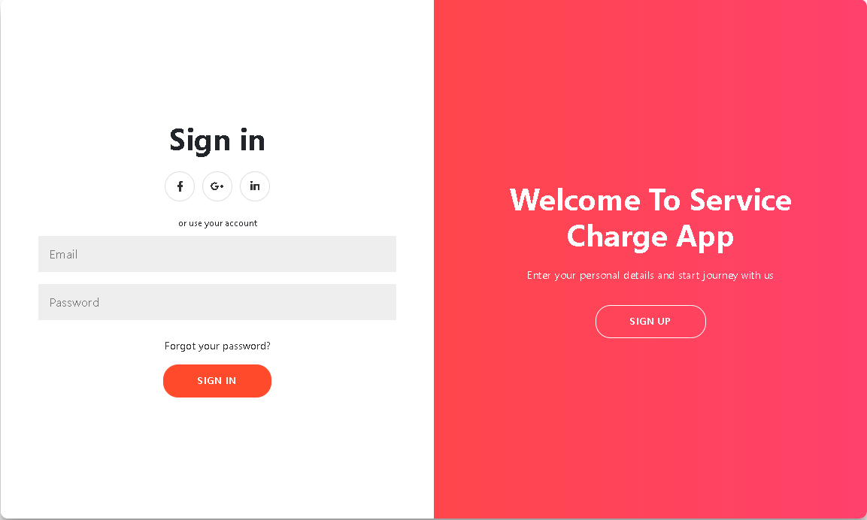
1.0 Sign In Page

Slide 6
1.0 Sign In Logic
Login:
Username This is the username of the user
Password This is the password of the user
Sign In
On Click
if fields are empty display “fields must not be empty”
if email is not in registered account
display “no account for <username>”
if credentials are correct
redirect to main page
Forgot your password
On Click
redirect to Forgot Password page
UPDATE TO TABLE

Slide 7
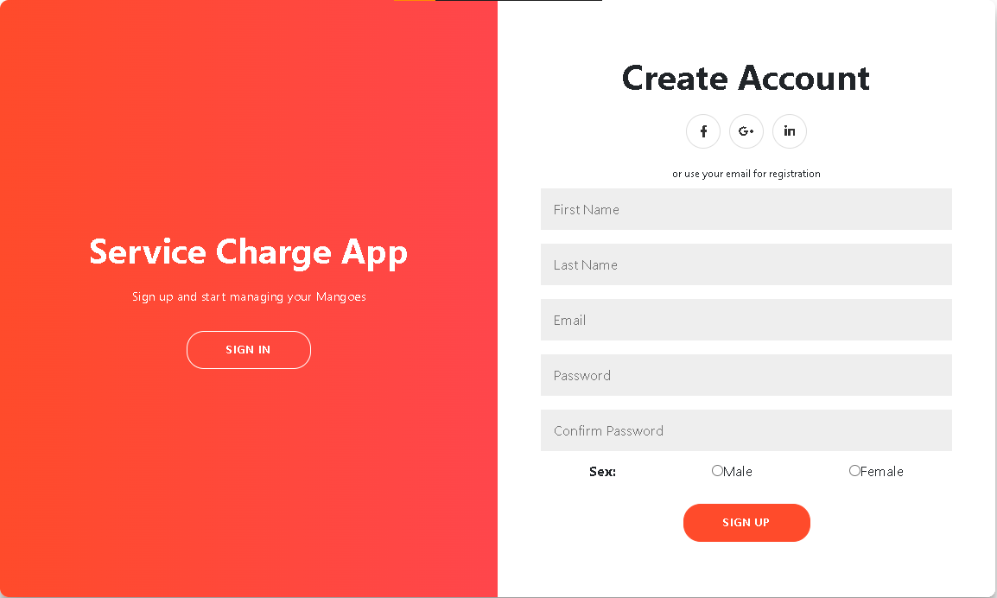
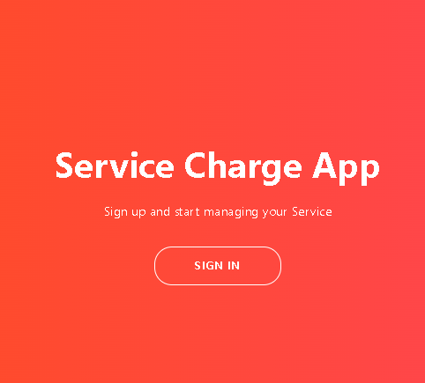
1.1 Register Page

Slide 8
1.1 Register Logic
Login:
First Name This is the first name of the user
Last Name This is the last name of the user
Email This is the email of the user
Password This is the password of the user
Sex This is the sex of the user
Sign Up
On Click
if fields are empty display “fields must not be empty”
if email is already in registered account
display “<username> is already registered”
if all input are valid
navigates to main page
UPDATE TO TABLE

Slide 9
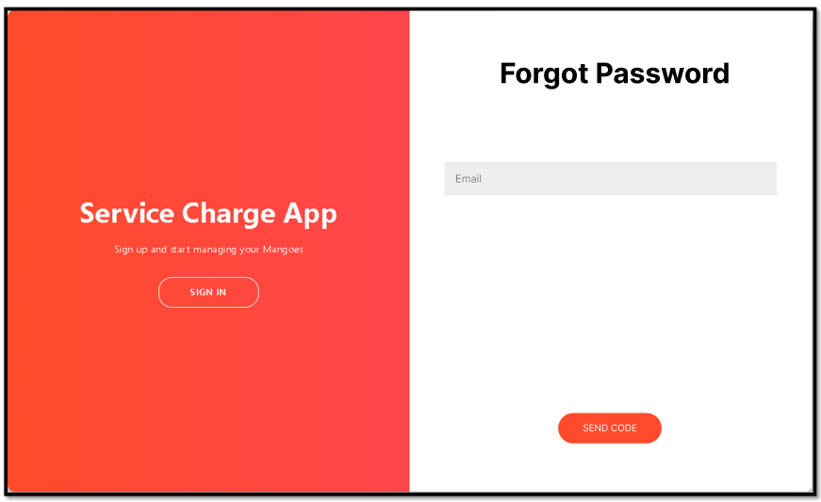
1.2 Forgot Password Page

Slide 10
1.2 Forgot Password Logic
Forgot Password:
Email This is the email of the user that he/she wants to retrieve
Send Code
On Click
if email is already in registered account
send otp code to email
navigates to Reset Password page
else
display “<username> doesn’t exists”
UPDATE TO TABLE

Slide 11
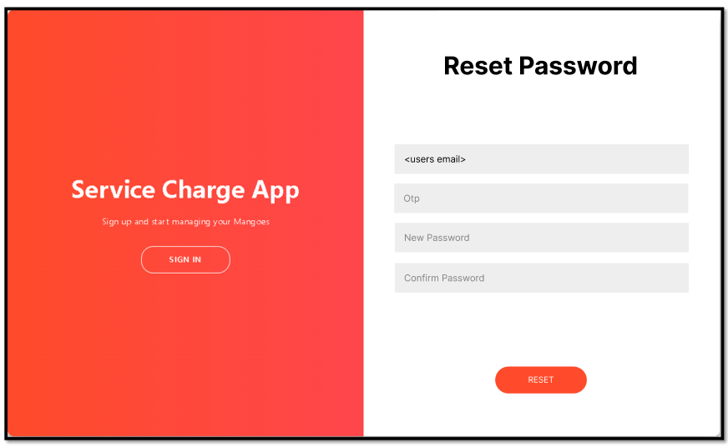
1.2.1 Reset Password Page

Slide 12
1.2.1 Reset Password Logic
Rest Password:
Otp this is the code needed for resetting the users password
New Password this the new password of the user
Confirm Password this the confirmed password of the user
Reset
On Click
if otp is not correct display “<otp> is incorrect”
if password does not match display “password doesn’t match”
else
resets the users password
navigates to Login page
UPDATE TO TABLE

Slide 13
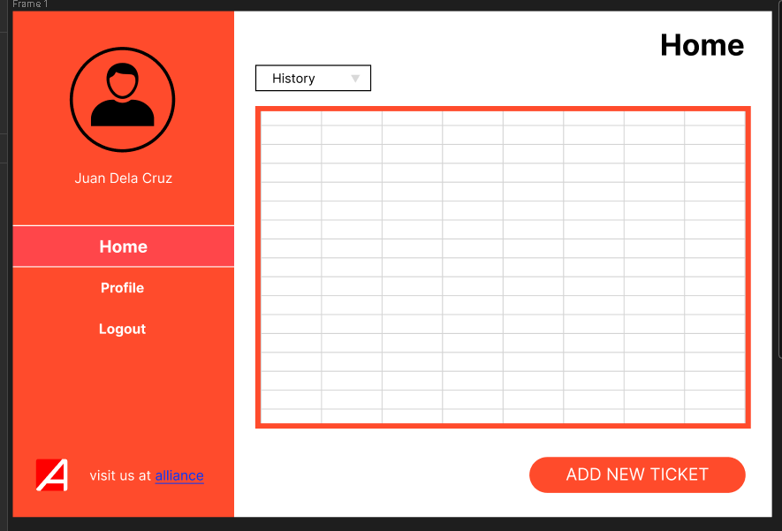
1.3 Main Page

Slide 14
1.3 Main Page Logic
Home:
History this is the data history of user
Profile
On Click
navigates to Profile page
Logout
On Click
prompt the user if he/she wants to logout if yes
logout
Add New Ticket
Navigates to Add New Ticket page
UPDATE TO TABLE

Slide 15
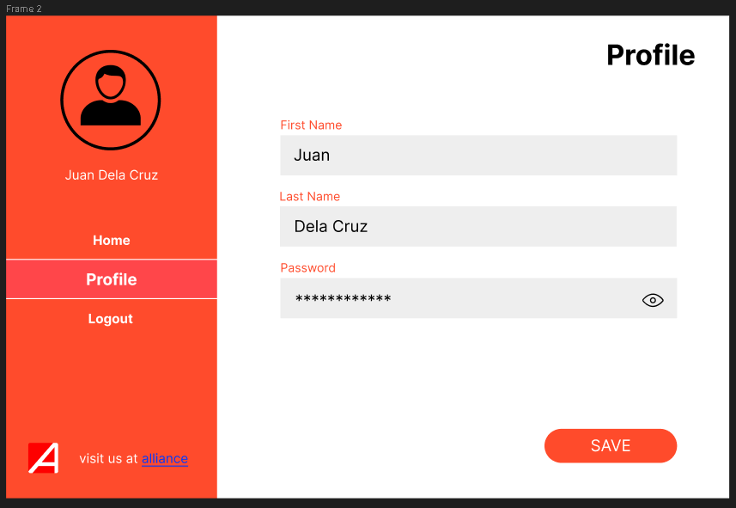
1.4 Profile Page

Slide 16
1.4 Profile Logic
Profile:
First Name This is the first name of the user
Last Name This is the last name of the user
Password this the password of the user
Home
On Click
navigates to Main page
Logout
On Click
prompt the user if he/she wants to logout if yes
logout
Save
On Click save new changes
UPDATE TO TABLE

